Slide 1

HOW TO APPLY IULM STYLE SHEETS TEMPLATE
TO YOUR THESIS/DISSERTATION
Edited by Ibrahima Mbengue
IULM Library
Multimedia Services
Last update May 2020
IULM Library / Multimedia Services

Slide 2
COURSE CONTENTS
What is a Style Sheet?
Advantage of a Style Sheet;
Download and Installation;
Getting started with Iulm Style Sheet Template;
Creating a document based on the Style Sheet template;
Applying the Style Sheet to an existing Word document;
Generating an automatic Index/table of contents;
Special page numbering;
Converting your thesis to PDF;
Other useful Word functions for your thesis;
IULM Library / Multimedia Services

Slide 3
WHAT IS A STYLE SHEET?
A style sheet is a predesigned thesis template based on Word styles;
A style is a set of text formatting characteristics applied to content (chapter style, thesis body style, citation style, margins, font type, paragraph line spacing…)
IULM Library / Multimedia Services

Slide 4
ADVANTAGES OF USING IULM STYLE SHEETS
Iulm thesis formatting template provides built-in formatting for text and heading styles, margin settings, section breaks and page numbering, and place-holders for automatically generated table of contents, lists of figures, tables and plates…
Iulm Style Sheet is the great way to save time and create consistent Office documents: using styles to format your thesis so you can quickly and easily apply a set of formatting choices consistently throughout your document.
IULM Library / Multimedia Services

Slide 5
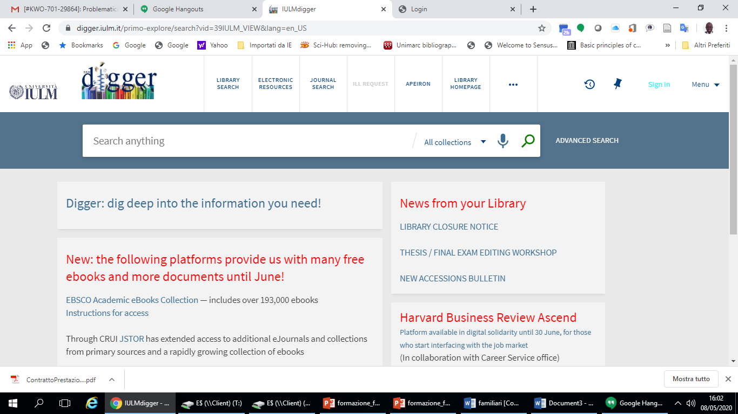
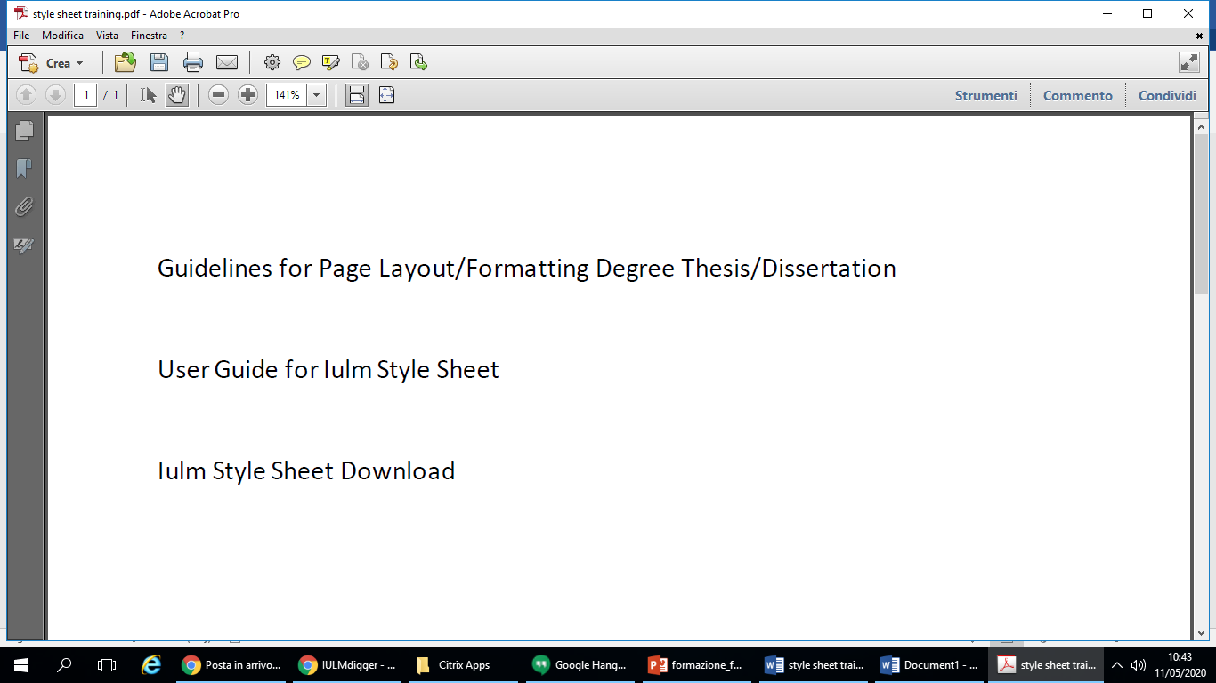
IULM STYLE SHEET DOWNLOAD
Connect to Iulm Online Library Platform Digger;
Then click THESIS / FINAL EXAM EDITING WORKSHOP;
And Download Iulm Style Sheet template
IULM Library / Multimedia Services

Slide 6
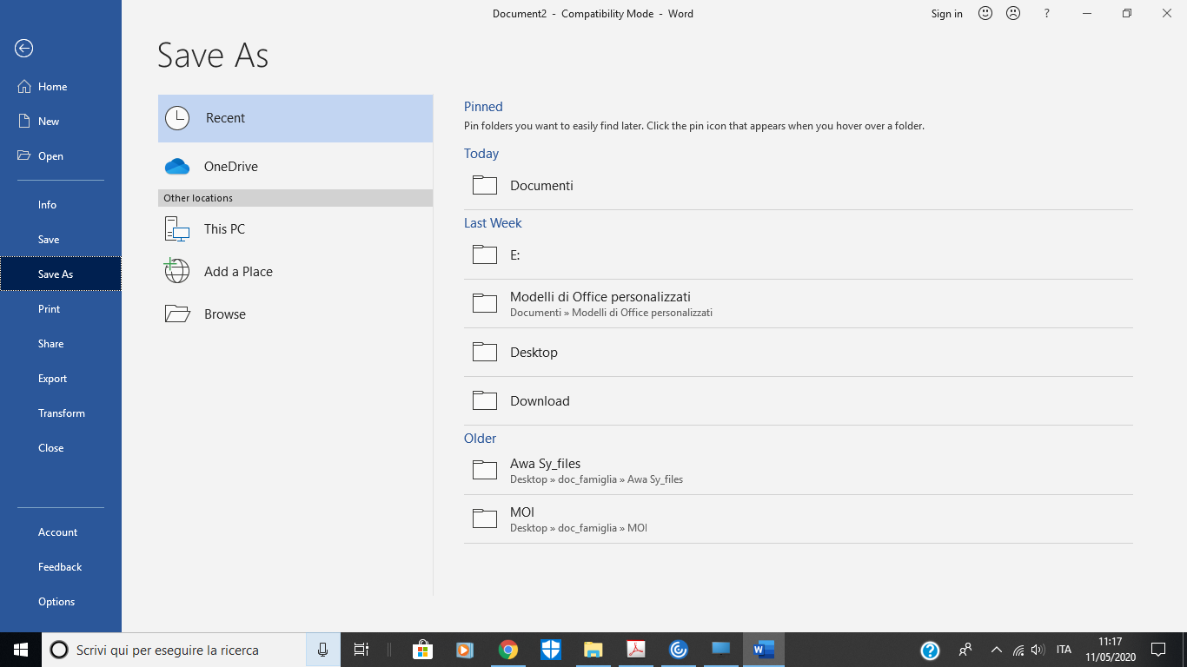
GETTING STARTED WITH THE STYLE SHEET
TEMPLATE DOWNLOAD
Open and Save the stylesheet as a Word template in a folder on your computer (preferably in Templates)
IULM Library / Multimedia Services

Slide 7
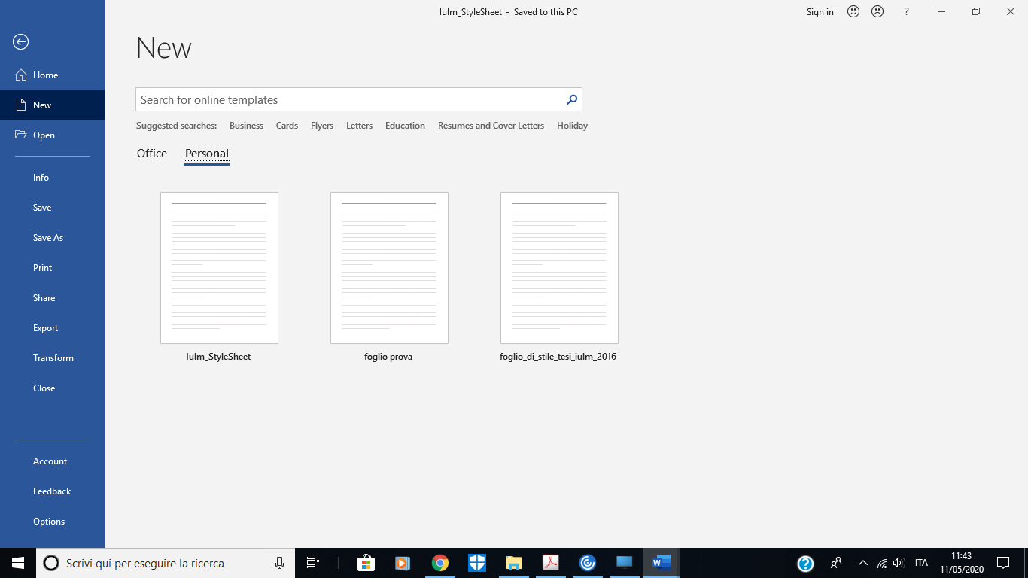
CREATING A DOCUMENT BASED ON IULM STYLE SHEET
Click on File, then click on New:
Under Templates click New from Personal and Select Iulm Stylesheet (format .dot)
IULM Library / Multimedia Services

Slide 8
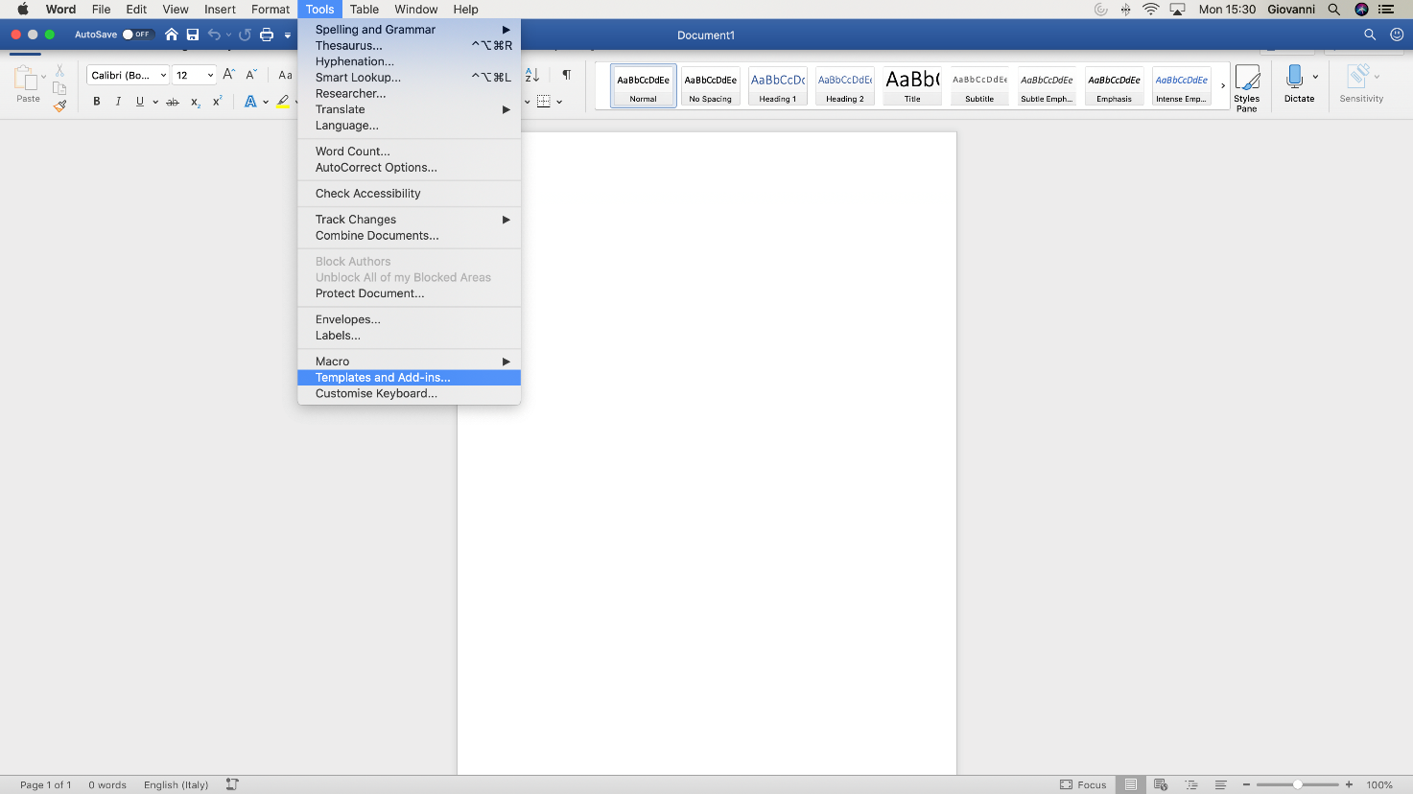
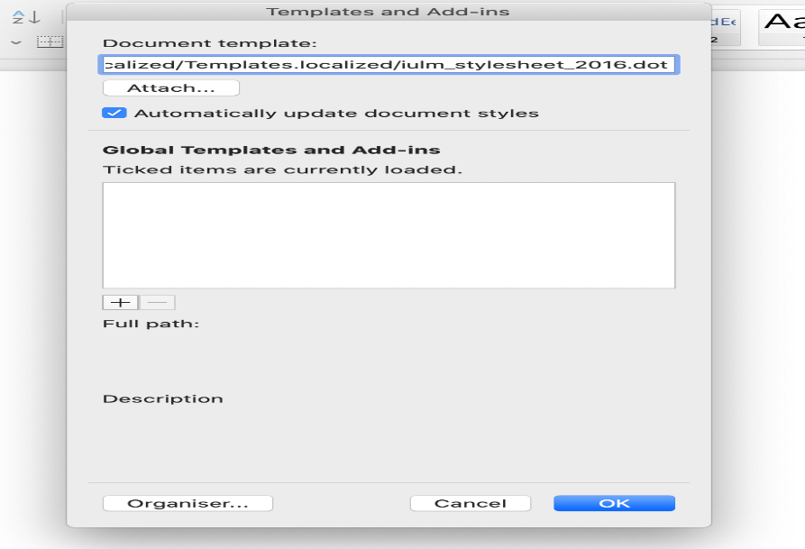

APPLYING THE IULM STYLE SHEET TO AN EXISTING DOCUMENT
PREVIOUS VERSIONS OF WORD 2007 AND WORD ON MAC
If you have already started writing your thesis, you can still apply the style sheet to your document, proceeding as follows:
Click tools, templates and Add-Ins
Select Attach;
Open Iulm Style Sheet, click Open and Insert a checkmark in the box «Automatically update styles» to apply Iulm Style Sheet to your file
IULM Library / Multimedia Services

Slide 9
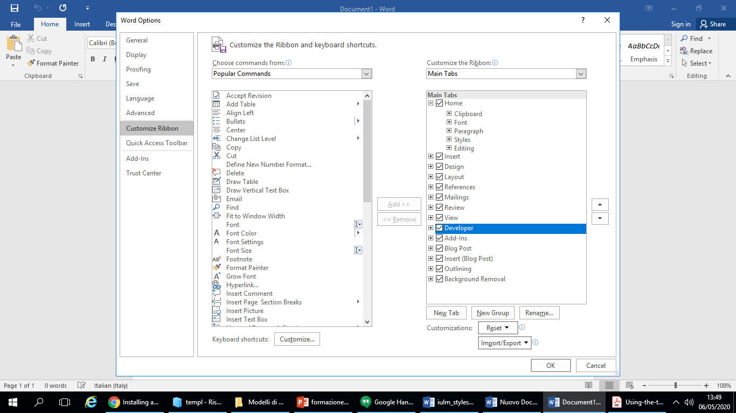
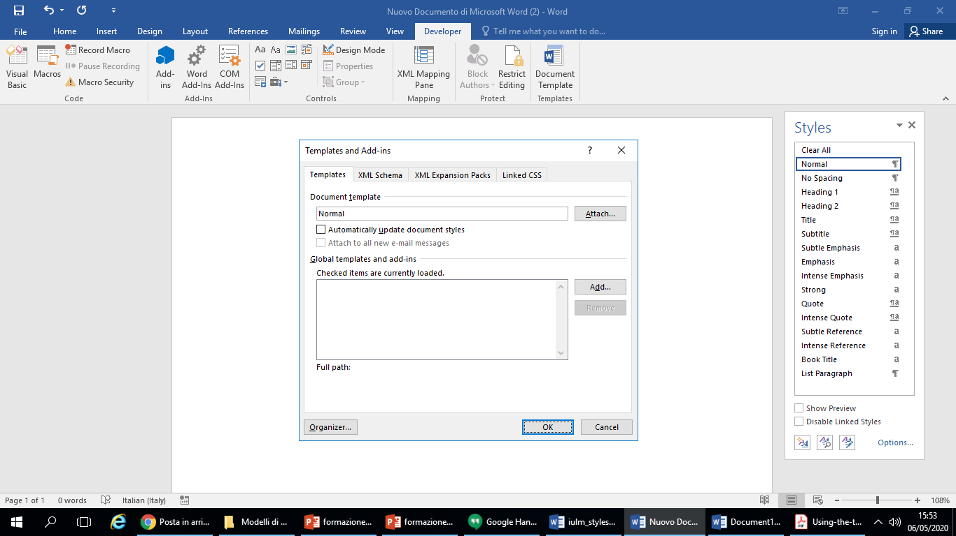
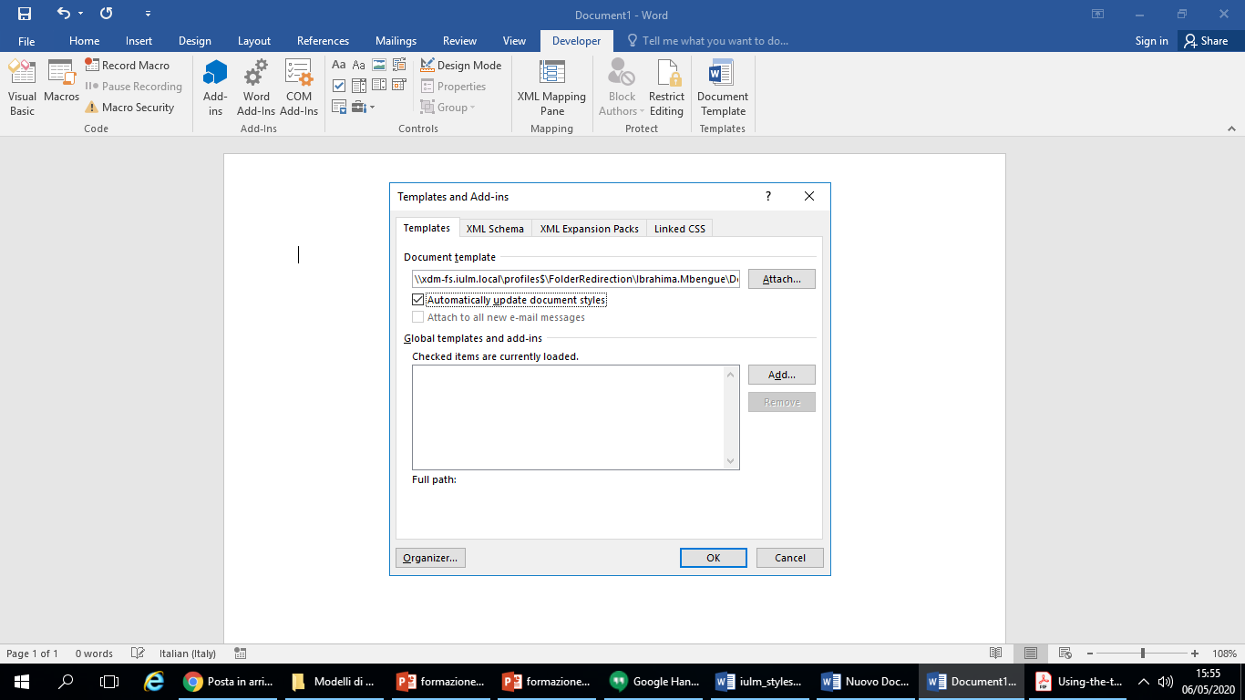
APPLYING IULM STYLE SHEET TO AN EXISTING TEMPLATE
WORD 2007 AND LATER VERSIONS
Enable «Show Developer» Tab (Word Customer Ribbon Bar);
Click on Developer
Select tools, templates and additions;
Click on Attach;
Open the desired template and click Open;
Enter a checkmark in the box «Automatically update styles» to apply Iulm Style Sheet to your file
IULM Library / Multimedia Services

Slide 10
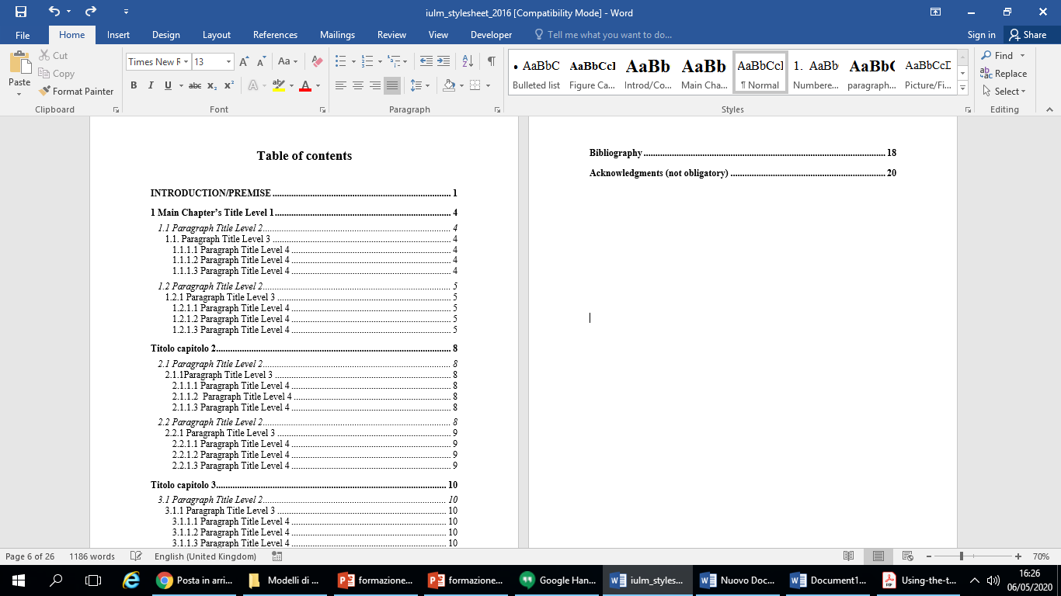
STARTING WITH IULM STYLE SHEET
DISPLAYING AND SAVING THE FILE
Layout model
Assign a name (Student ID Number - First Name Last Name) to the new template
IULM Library / Multimedia Services

Slide 11
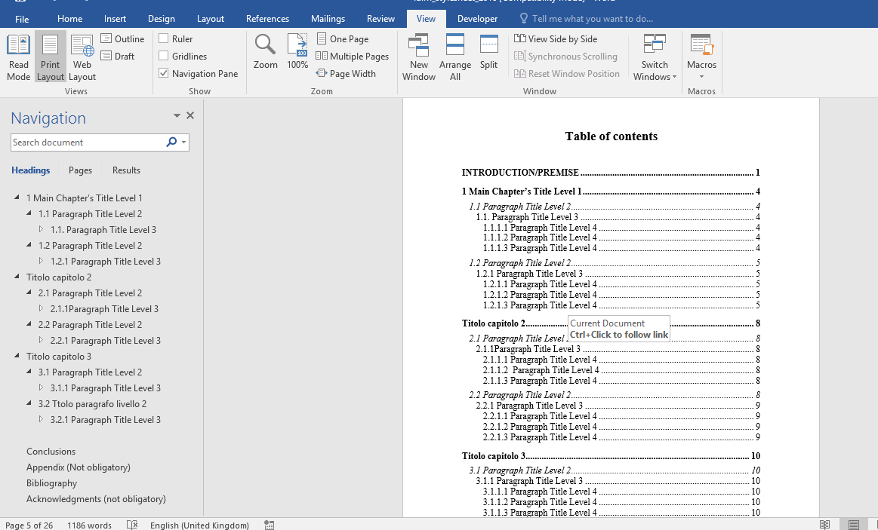
STARTING WITH IULM STYLE SHEET
OPENING AND SAVING THE FILE
The Navigation Pane lets you navigate through your document without scrolling
click the View tab in the Ribbon Bar
IULM Library / Multimedia Services

Slide 12
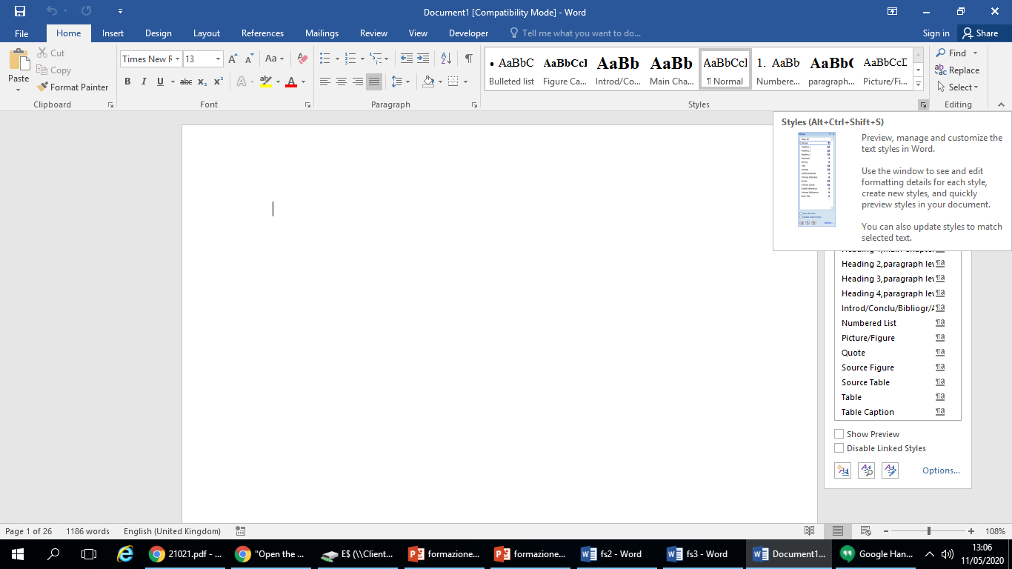
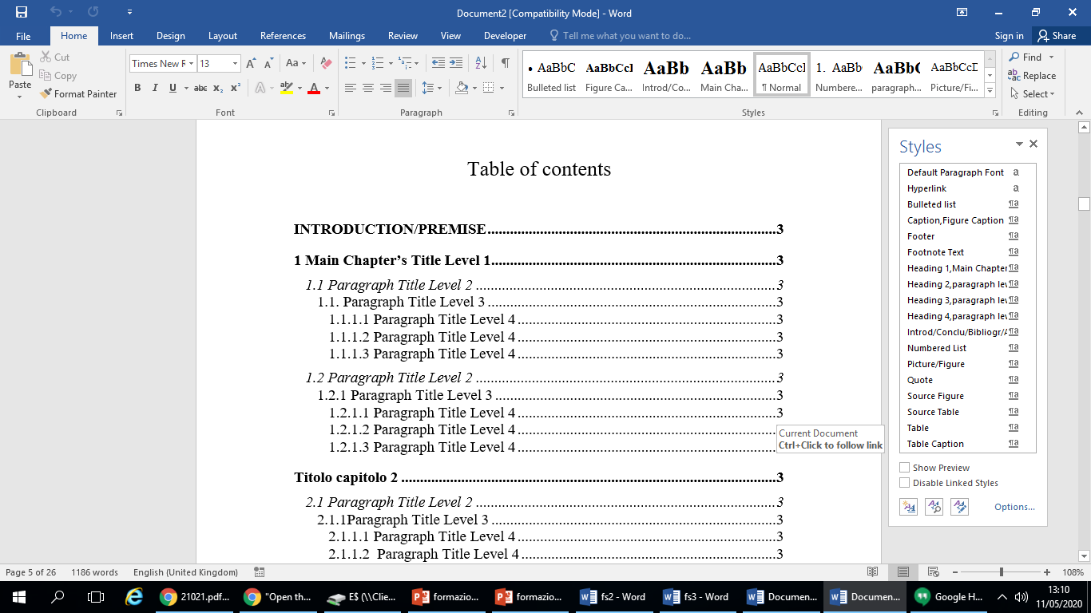
STARTING WITH IULM STYLE SHEET
DISPLAYING HEADING STYLES AND PARAGRAPHS
The Style group on the Home tab (right side of the screen) allows you to start editing or creating styles
IULM Library / Multimedia Services

Slide 13
STYLES CUSTOMIZATION AND APPLICATION
Each style has a name, for example:
Titles introd/conclu/bibliogr/acknow.
Title 1; Main chapter
Title 2; paragraph level 2
Title 3; paragraph level 3
Title 4; paragraph level 4
Thesis body
Caption; Figure Caption
Figure
IULM Library / Multimedia Services

Slide 14
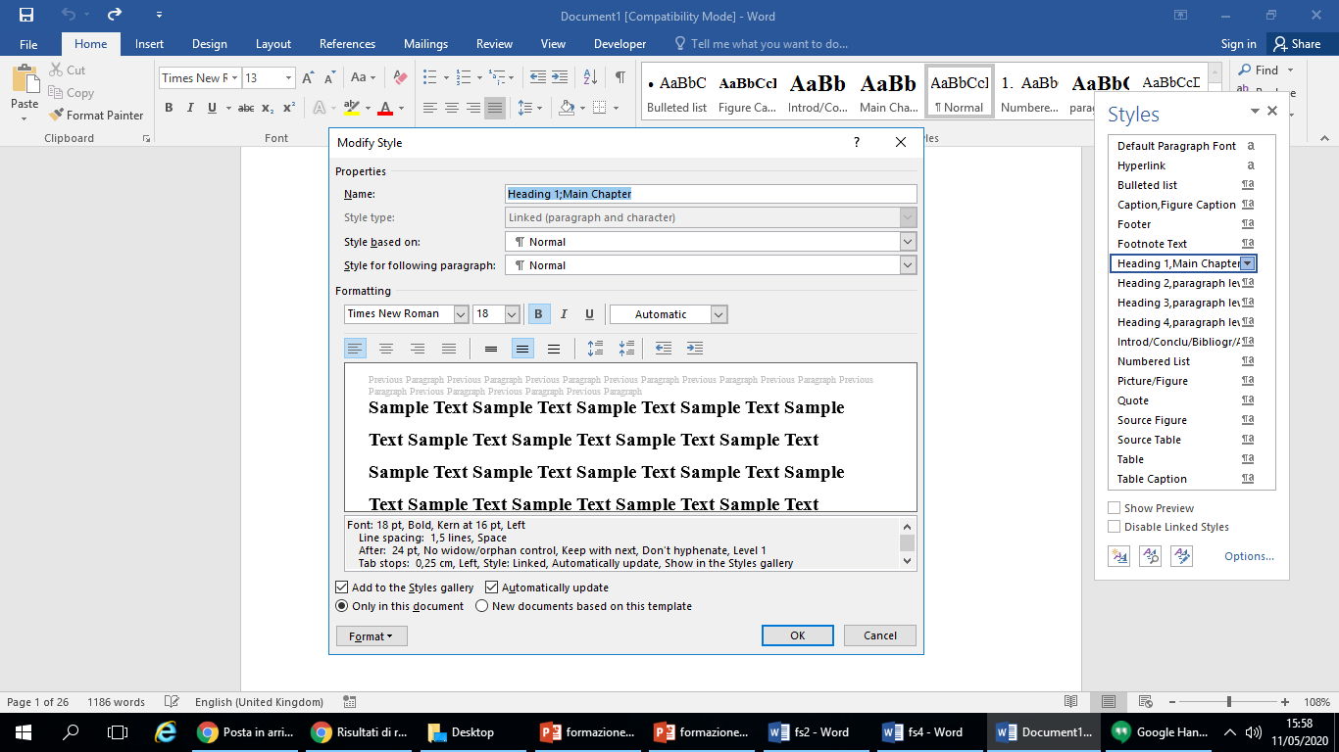
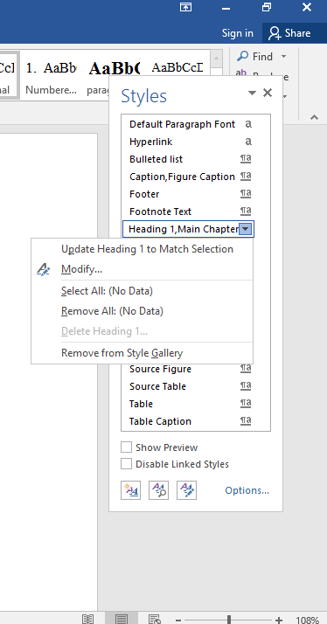
STYLES CUSTOMIZATION AND APPLICATION
To modify indents, paragraph spacing and other attributes, choose Format popup menu and click the name of desired style, use the pop-up menu to select the options, then click OK.
IULM Library / Multimedia Services

Slide 15
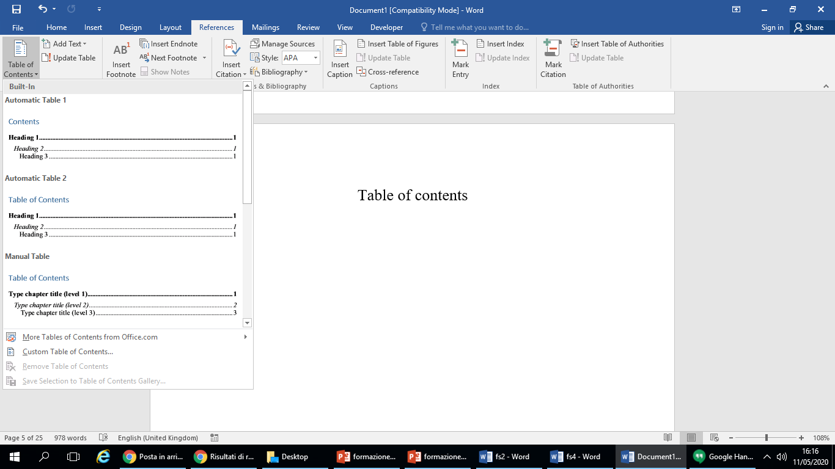
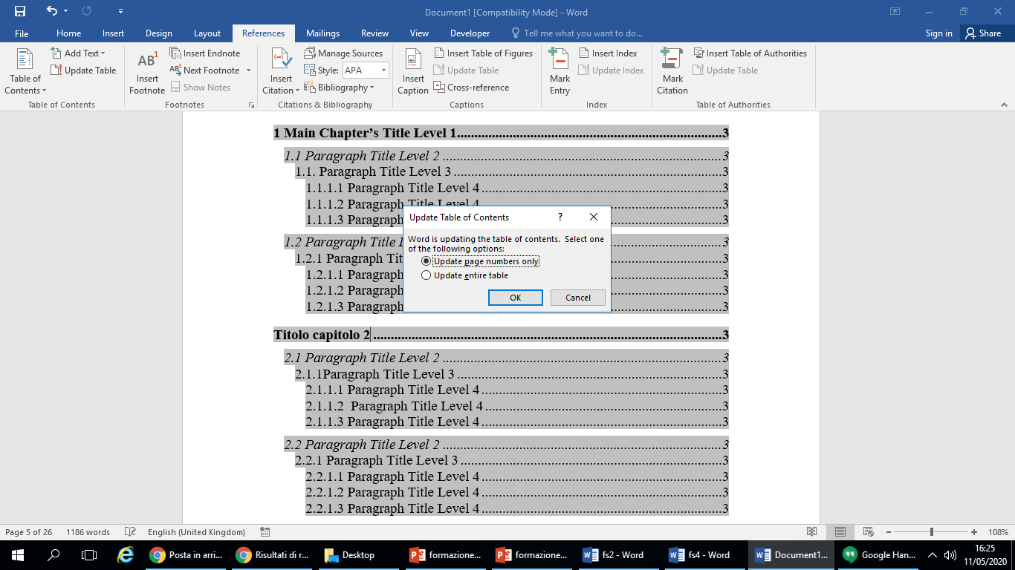

HOW TO INSERT OR TO MODIFY INDEX/TABLE OF CONTENTS
THESIS TABLE OF CONTENTS
3
2
You can insert an automatic table of contents according to the previous procedure (customization - application styles). Perform the following operations:
Place the cursor under Index/Table of contents;
Click the References tab
Then on Table of contents
Choose Insert Table of contents then define desired format, layers and options.
1
4
For further details: Updating Table of Contents > In the Table of Contents group of the References tab click Refresh Table of Contents then Refresh Page Numbers or Full Table of Contents
IULM Library / Multimedia Services

Slide 16
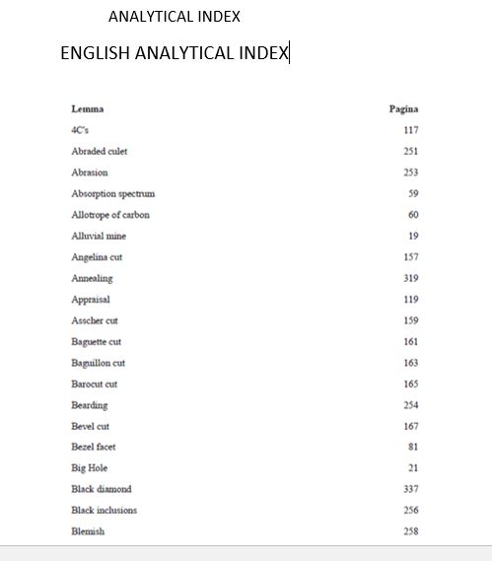
HOW TO INSERT OR TO MODIFY INDEX/TABLE OF CONTENTS
INDEX (EX.: GLOSSARY FOR THE SCIENTIFIC TRANSLATION COURSE)
The analytical index contains the list of relevant words that recur in the text, with the corresponding page number. This index is very useful in the context of degree courses in Interpreting and communication / Specialised translation and conference interpreting
IULM Library / Multimedia Services

Slide 17
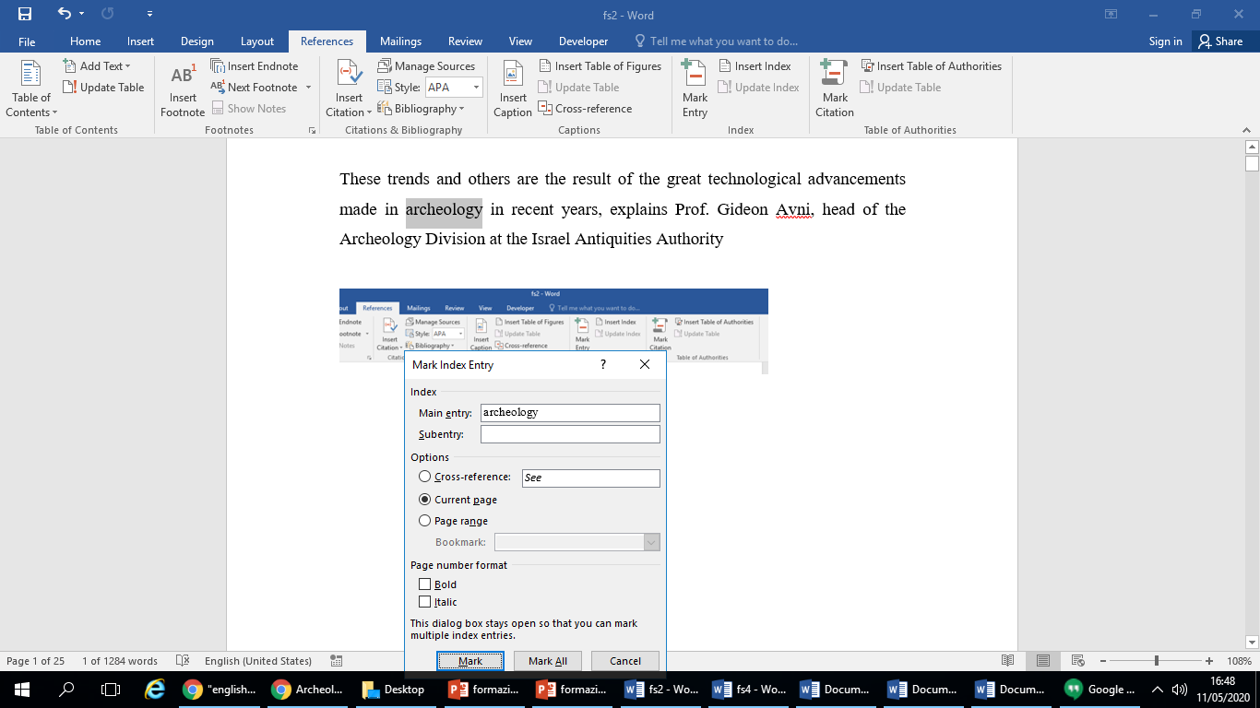
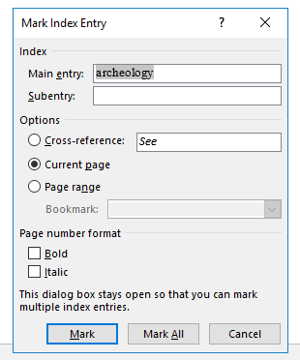
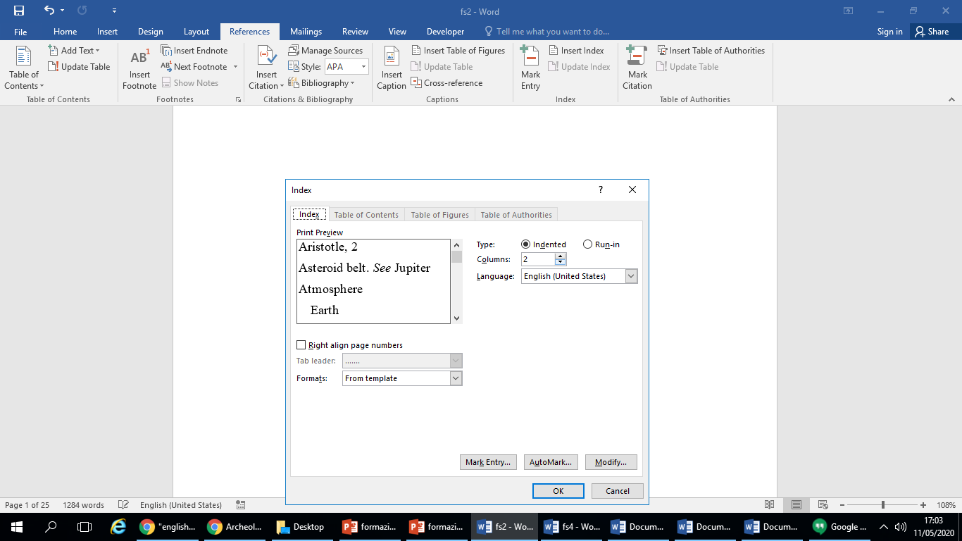
HOW TO INSERT OR TO MODIFY INDEX/TABLE OF CONTENTS
ANALYTICAL INDEX
in the Index group of the References tab click Mark Entry or Mark All for all similar entries;
Type or edit the customizable item then enter a secondary or cross entry according to your needs;
Place on the page where you want to insert the index;
Click Insert Index and follow the guided procedure (next options)
IULM Library / Multimedia Services

Slide 18
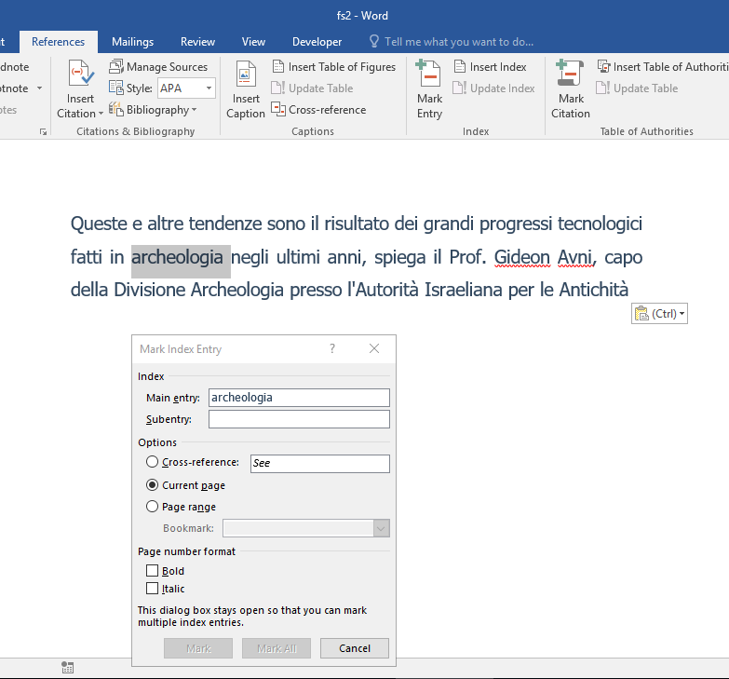
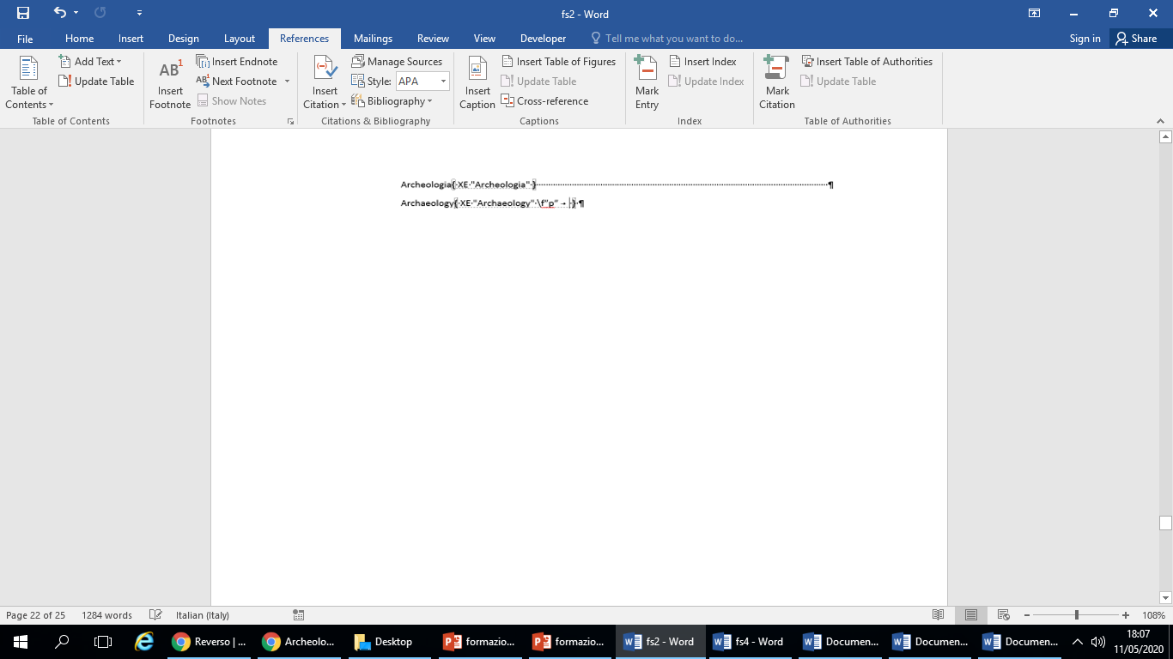
HOW TO INSERT OR TO MODIFY INDEX/TABLE OF CONTENTS
ANALYTICAL INDEX
(Second Index)
1
When inserting a second index, Word replaces the first index with the new one ... unless the following solution is resorted to :
Select the words and click on References group, Mark entry tab then on ok. Word adds a field named XE (If the XE field is not displayed, click Show/Hide in the Paragraph group on the Home tab to activate it)
Add the parameter “f” to the XE field, then choose a unique letter, for ex. “ p ” (The second index will be created on the basis of letter “ p ” ex. { XE “ archaeology ” \f “p”}
2
IULM Library / Multimedia Services

Slide 19
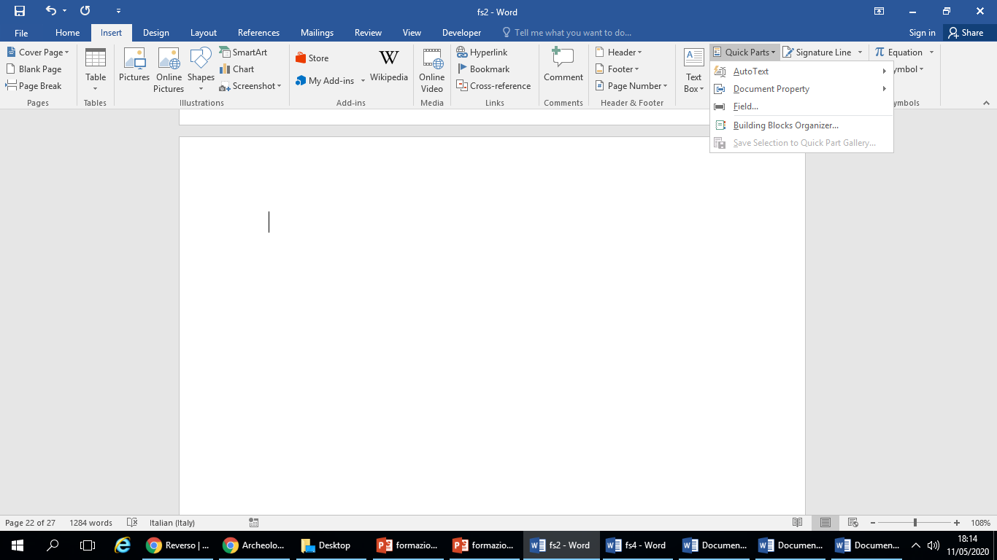
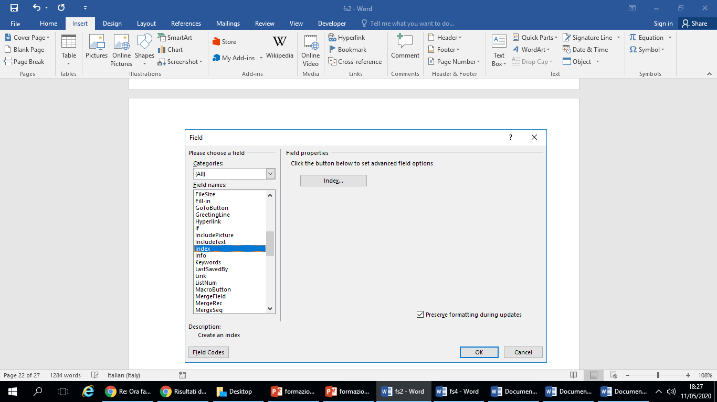
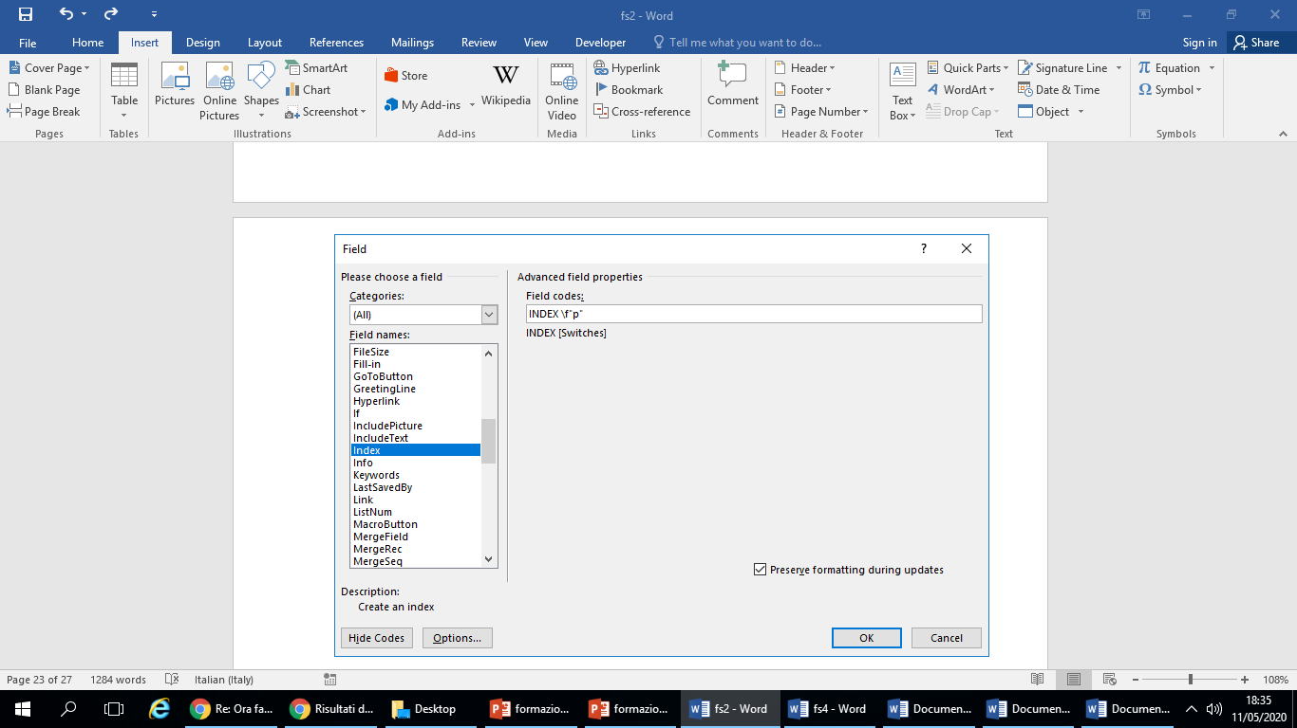
HOW TO INSERT OR TO MODIFY INDEX/TABLE OF CONTENTS
ANALYTICAL INDEX (Second Index)
3
Proceed as follows: Enter > Quick Parts > Field > Index; field code;
Click on Field codes;
Enter the following parameters: INDEX f «p», and then on ok
4
5
IULM Library / Multimedia Services

Slide 20
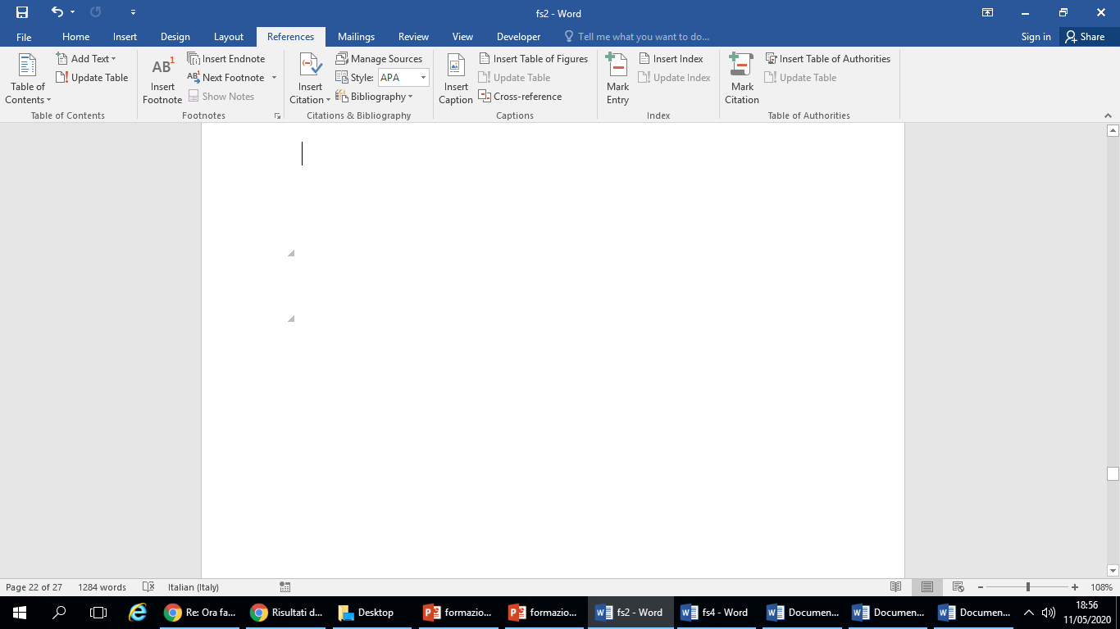
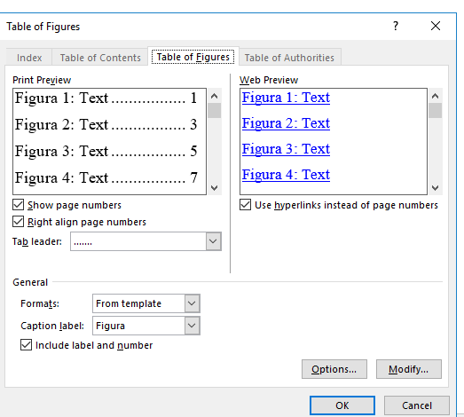
HOW TO INSERT OR TO MODIFY INDEX/TABLE OF CONTENTS
TABLE OF FIGURES
Before creating an Index of figures, it is essential to add captions to all the figures and tables that you want included in your Table of Figures
For more information, see Insert/fix images in Word
Click on the page where you want to insert the index;
In the Index group of the References tab click Insert Table of Figures;.
IULM Library / Multimedia Services

Slide 21
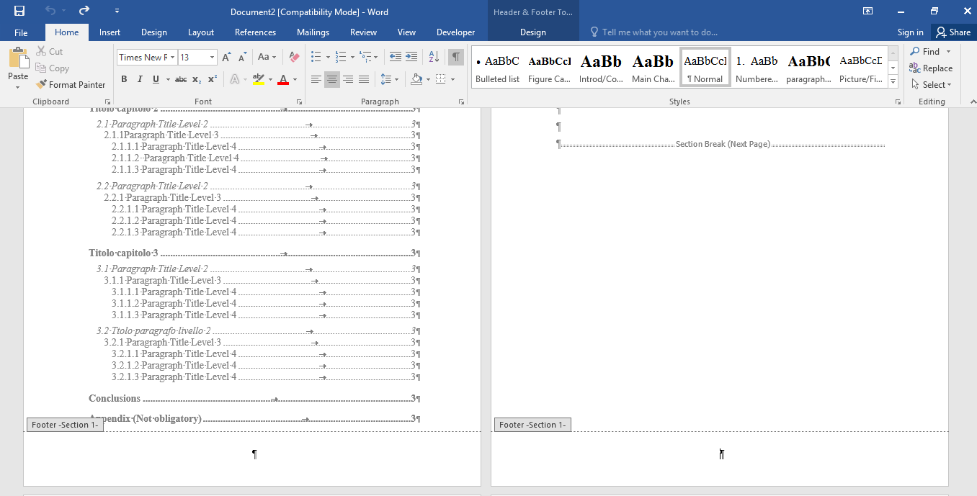
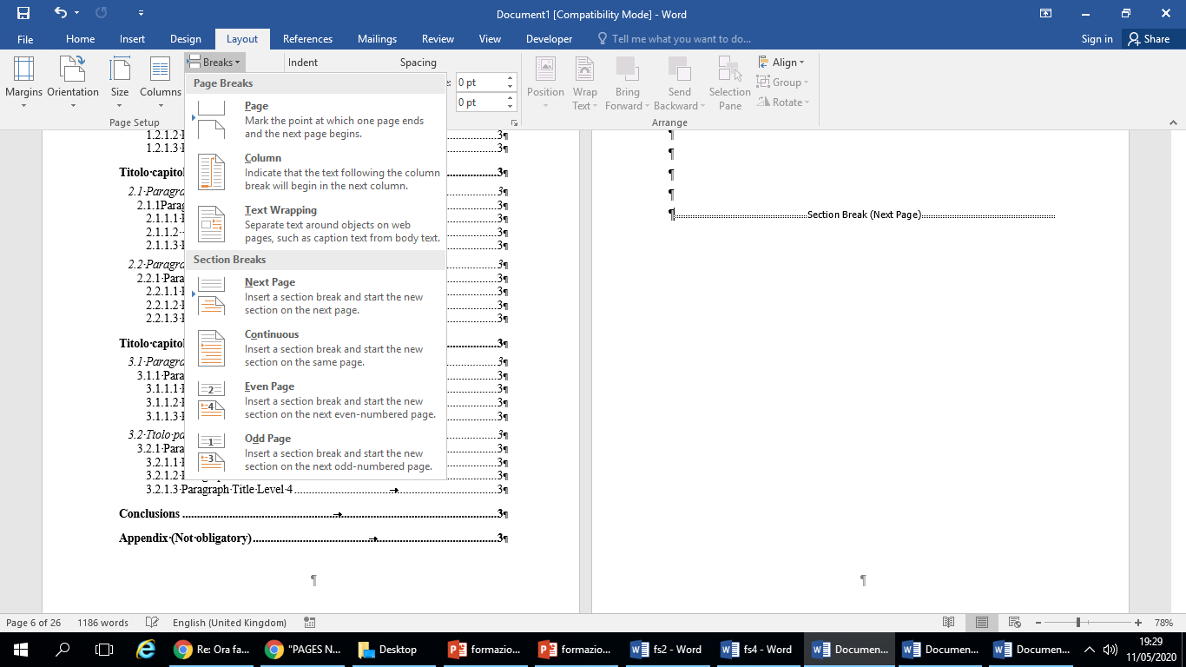
SPECIAL PAGES NUMBERING
STARTING PAGE NUMBERS FROM THE INTRODUCTION
1
2
In the Paragraph group of the Home tab choose Show/Hide ( ) to enable the display of formatting marks.
Place with the cursor at the end of the page preceding the introduction;
5
3
4
Layout Group
Breaks
Section breaks, then next page
IULM Library / Multimedia Services

Slide 22
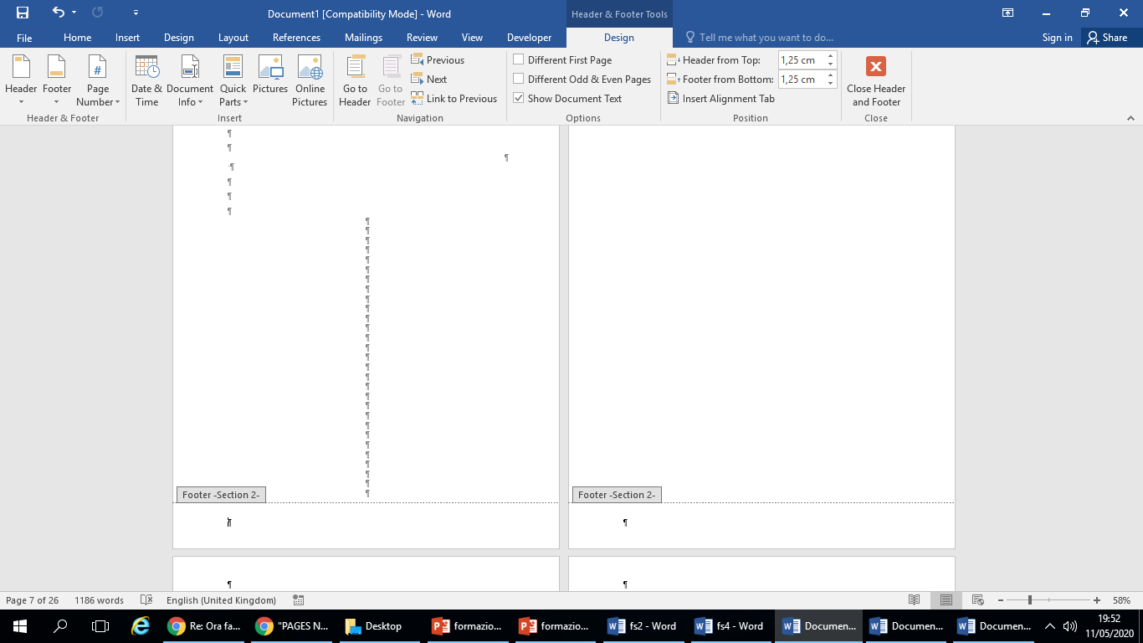
SPECIAL PAGES NUMBERING
STARTING PAGE NUMBERS FROM THE INTRODUCTION
7
8
7
9
Open the footer by double clicking on the bottom of the page hosting the introduction.
The Design option in Header and Footer Tools will be opened ;
Disable Link to Previous
IULM Library / Multimedia Services

Slide 23
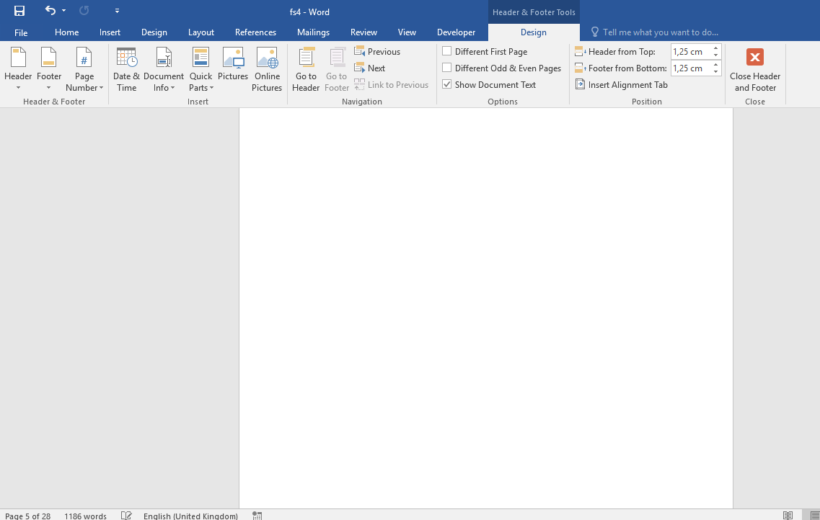
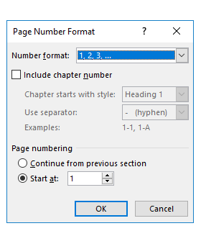
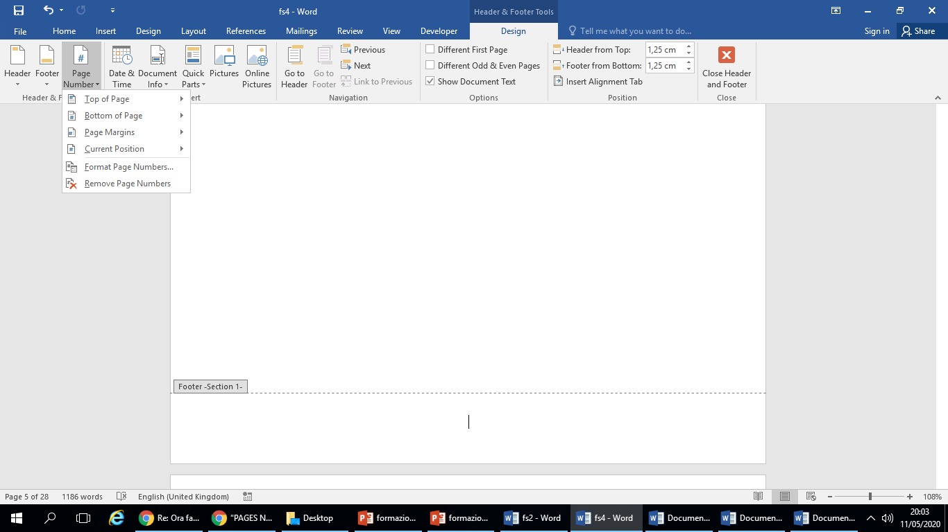
SPECIAL PAGES NUMBERING
STARTING PAGE NUMBERS FROM THE INTRODUCTION
10
Click on the 'Page number' button
Then on Format page numbers;
Enter the number 1 in Start at and confirm the operation by clicking on OK
11
12
IULM Library / Multimedia Services

Slide 24
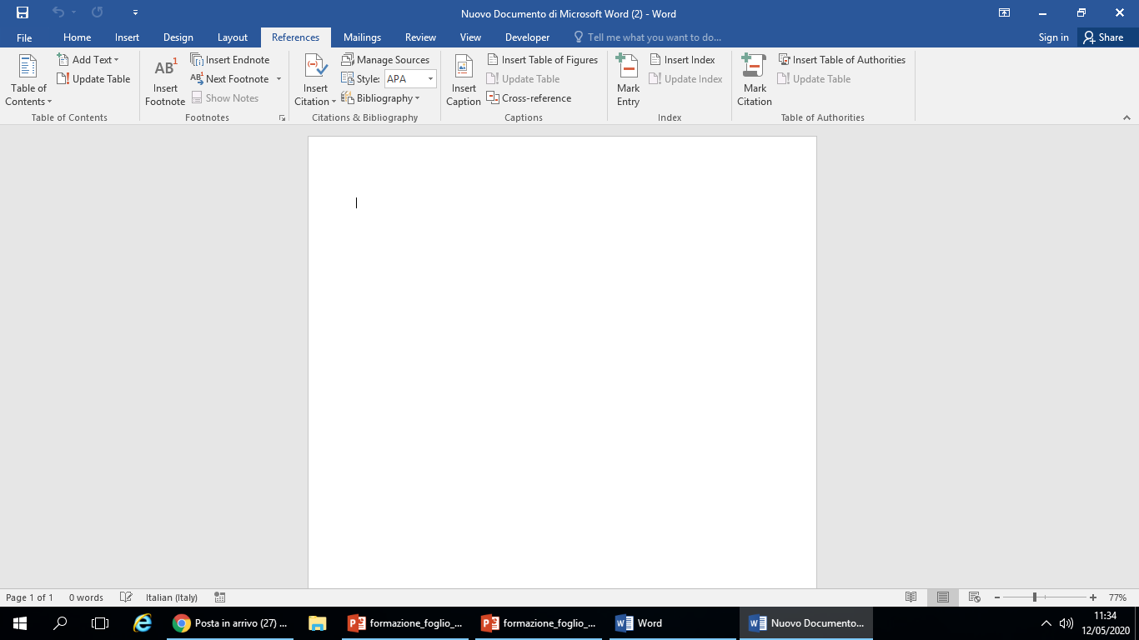
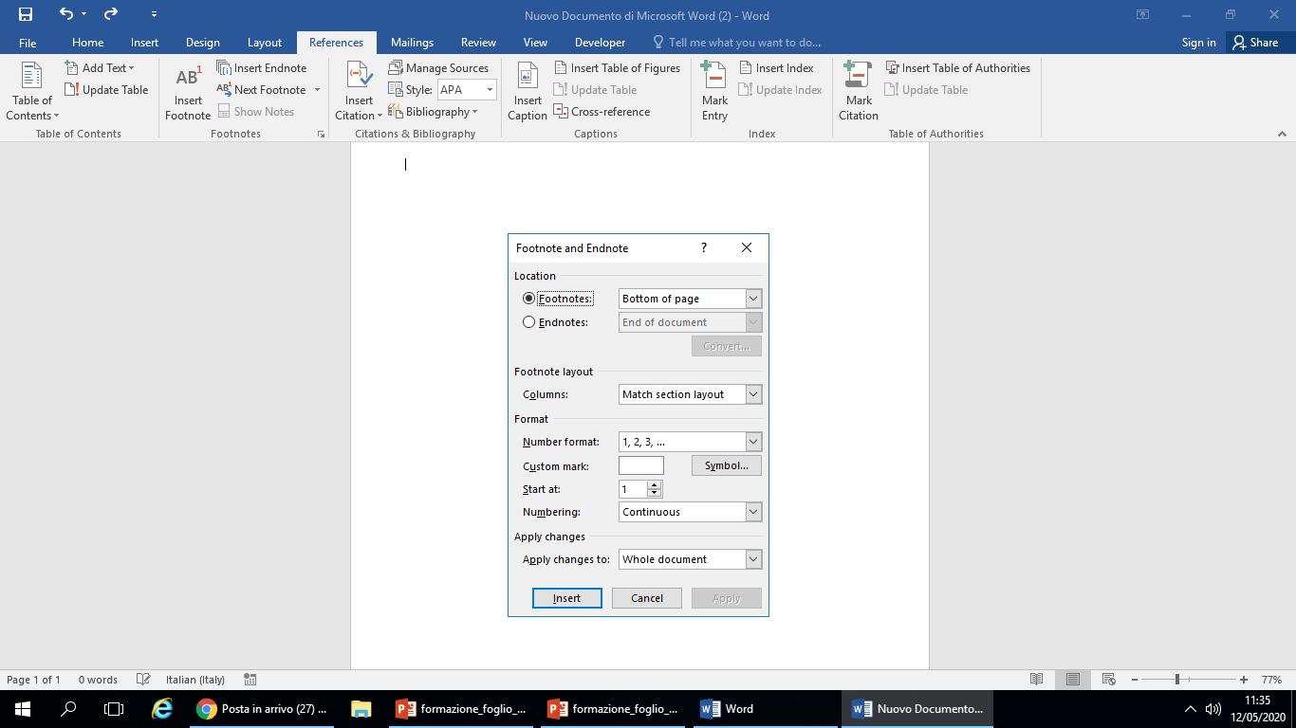
OTHER USEFUL FUNCTIONS OF WORD
FOOTNOTES
1
Click «References tab»
Then on Footnotes and select button Insert footnote ;
At the bottom of the page indicate the sequence number of the note
02
03
IULM Library / Multimedia Services

Slide 25
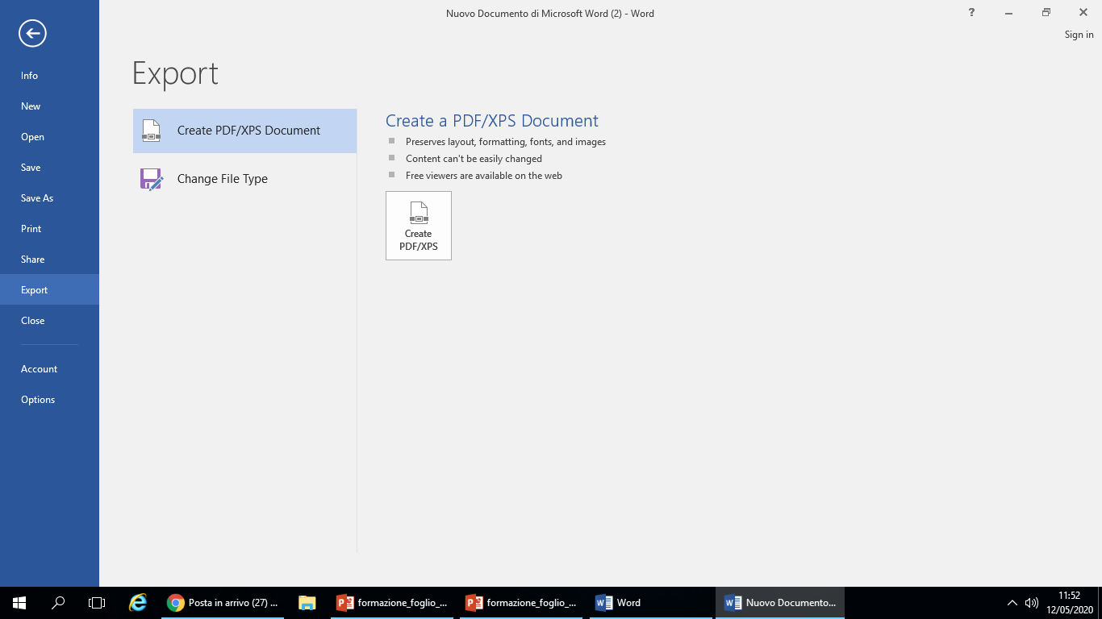
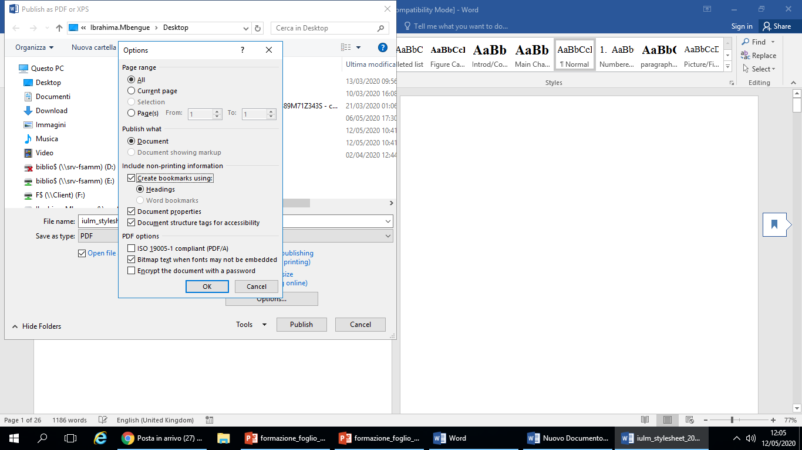
HOW TO CONVERT YOUR THESIS TO PDF
WORD 2007 AND LATER VERSIONS
1
From Word 2007 and above:
Click on the File Menu and select
Export or Save As (Student ID Number_Name_Surname);
Click the Options button and enable Create Bookmarks
2
3
IULM Library / Multimedia Services

Slide 26
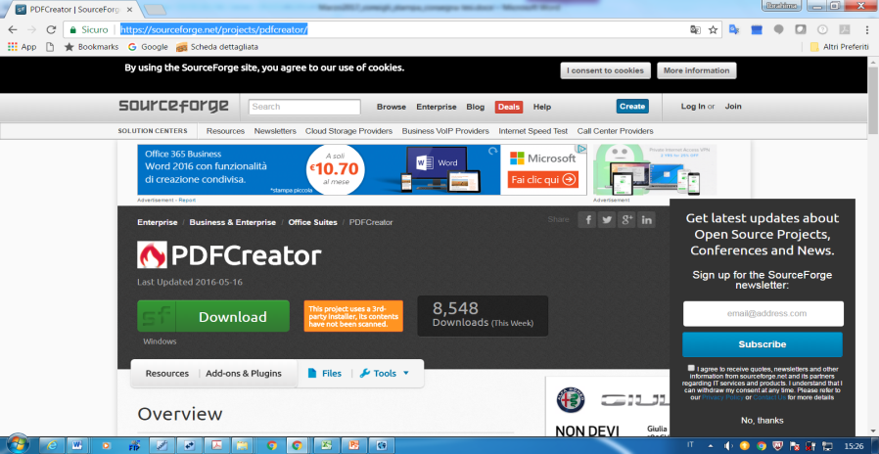
HOW TO CONVERT YOUR THESIS TO PDF
WORD VERSIONS PREVIOUS TO WORD 2007
1
If you don’t have the PDF option enabled in Microsoft Word 2007 or later versions:
download and install PDF Creator from this link: https://sourceforge.net/projects/pdfcreator/
File/Print
Select PDF Creator
Select High quality.
3
4
2
IULM Library / Multimedia Services

Slide 27
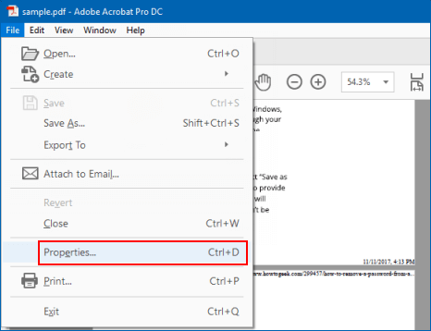
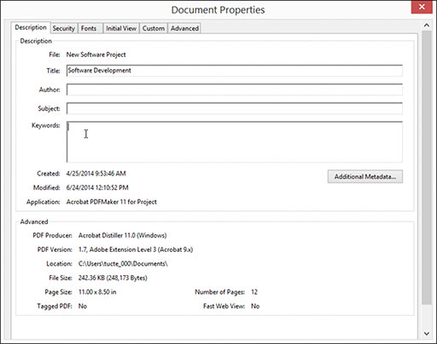
HOW TO CONVERT YOUR THESIS TO PDF
FINAL PDF METADATA
1
Click on File
Then on Property
Click on a tab in the Description document dialog box and enter title, author, subject and keywords
2
3
IULM Library / Multimedia Services

Slide 28
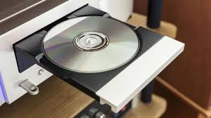
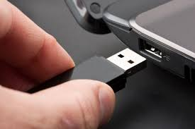
HOW TO BURN YOUR FINAL PDF TO CD
(WINDOWS 10)
1
Insert the blank CD into the CD player/burner
Insert the flash drive into the appropriate usb output
2
IULM Library / Multimedia Services

Slide 29
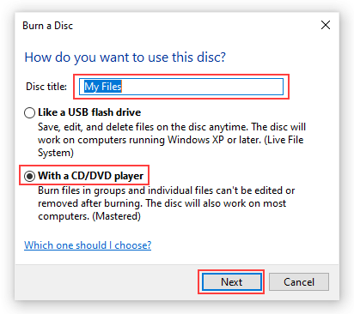
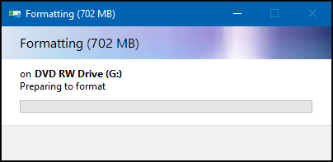
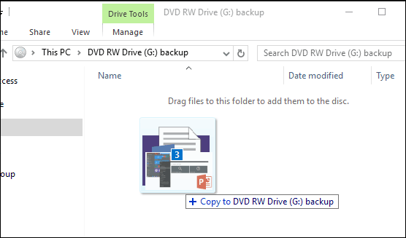
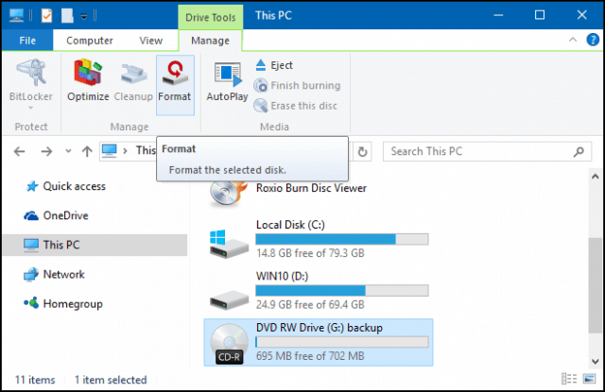
HOW TO BURN YOUR FINAL PDF TO CD
(WINDOWS 10)
A burn disc wizard will appear on the screen; insert the disc title, then choose the option With a CD/DVD player;
Click Next then wait while the disc is prepared for use.
Then wait while the disc is prepared for use.
Open File Explorer and drag the pdf you want to burn;
Click the Manage tab and then Eject
4
6
5
8
7
IULM Library / Multimedia Services

Slide 30
OTHER USEFUL FUNCTIONS OF WORD
How to combine and merge multiple files into one (thesis chapters);
How to insert and fix images in Word
IULM Library / Multimedia Services

Slide 31
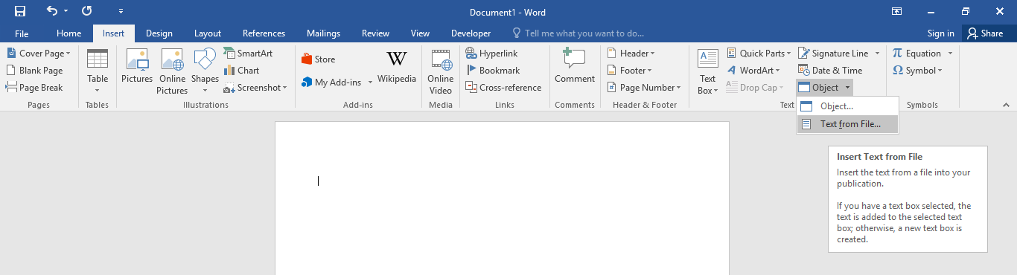
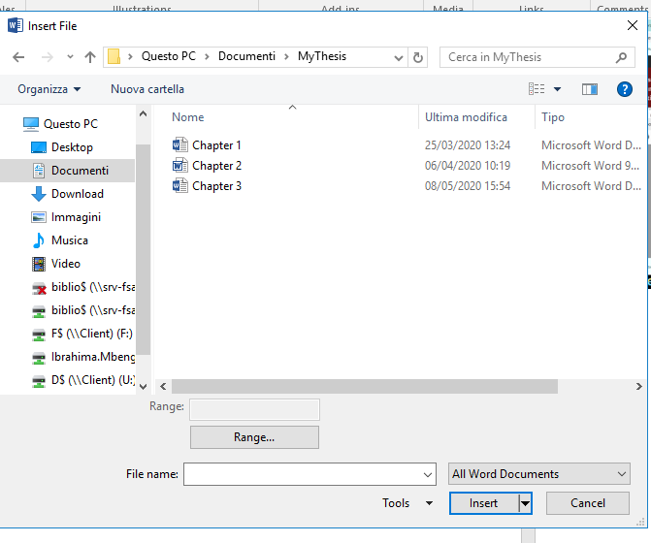
OTHER USEFUL FUNCTIONS OF WORD
HOW TO COMBINE AND MERGE MULTIPLE FILES (THESIS CHAPTERS) INTO ONE
1
2
Create a new blank document and then configure the page layout settings (based on the Style Sheet) for the documents that are going to be merged.
Click on the drop-down to the right of the button 'Object' then on 'Text from file '
Select the files you want to merge and combine to one by holding the _ CTRL _ (Windows_ ) or _ CMD_ (Mac) key then Insert
3
IULM Library / Multimedia Services

Slide 32
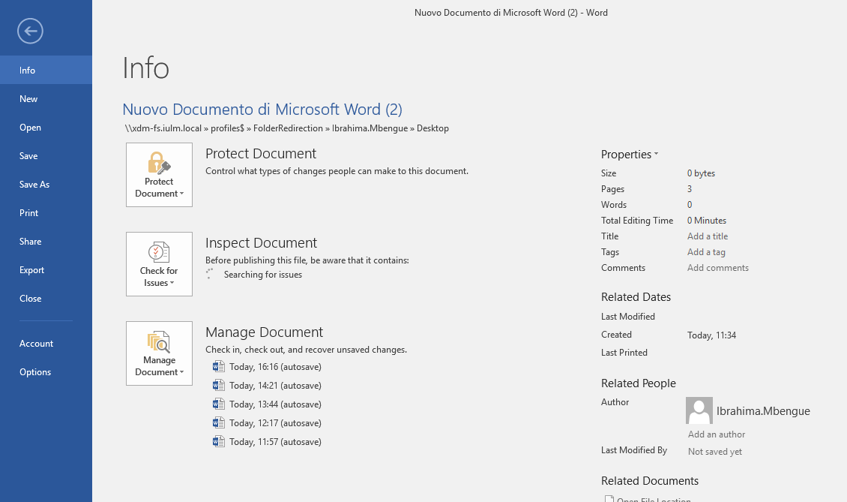

OTHER USEFUL FUNCTIONS OF WORD
INSERT/FIX IMAGES (WORD 2007 AND LATER VERSIONS)
The anchor function in Word allows you to fix the exact images in the stylesheet, so that they remain in place even in case of change in your document.
1
Display the File tab of the ribbon and then click Options
Click Display at the left side of the dialog box, Select the Object Anchors check box and press OK (on Mac: Preferences /Display/Object Anchors
2
IULM Library / Multimedia Services

Slide 33


OTHER USEFUL FUNCTIONS OF WORD
INSERT/FIX IMAGES (WORD 2007 AND LATER VERSIONS)
4
Clicking twice on the image Word displays Format Picture dialog box to change the image layout (Top right position)
Choose Size and Position option in the style sheet to enable Fixed position on page with several options (moving the image in front of text and behind text, or flowing text around the image with a square wrap, tight wrap or top and bottom wrap)
3
IULM Library / Multimedia Services

